Slide 1
EXCEL ASSESSMENT
-Varun Das

Slide 2
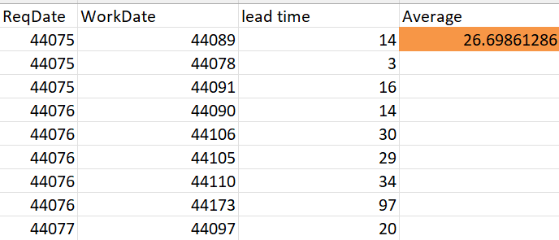
TASK 1

Slide 3
TASK 1 Inference
From the above image we can conclude that the average lead time between the request date and the completion date is 26.69

Slide 4
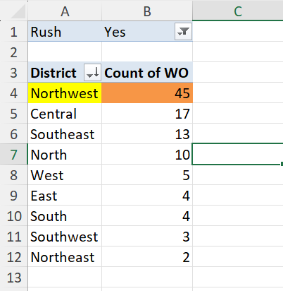
TASK 2

Slide 5
TASK 2 Inference
By calculating the count of work with the filter having only rush jobs
We can conclude that the NorthWest district has the highest number of rush jobs.

Slide 6
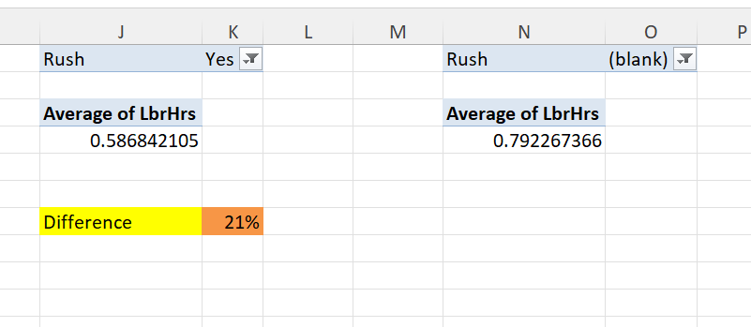
TASK 3

Slide 7
TASK 3 Inference
By taking the the average of labour hours with the filter of rush jobs and non rush jobs.
And then taking the difference between the both.
We can conclude both of them having the average difference of 21%.

Slide 8
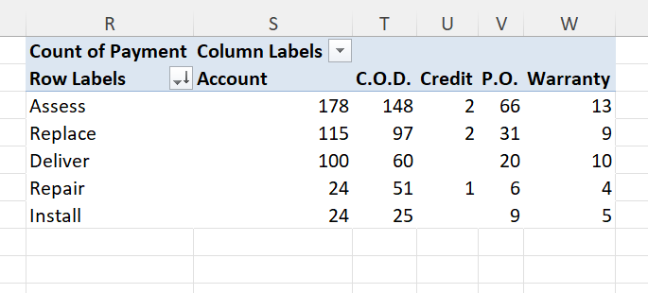
TASK 4

Slide 9
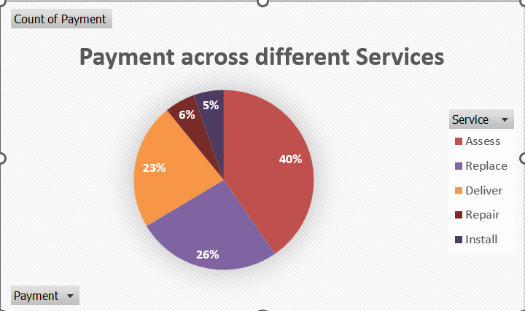
TASK 4

Slide 10
TASK 4 Inference
By taking the payment in columns and service in rows and the count of payments in values.
We can see how the data is being distributed across different services

Slide 11
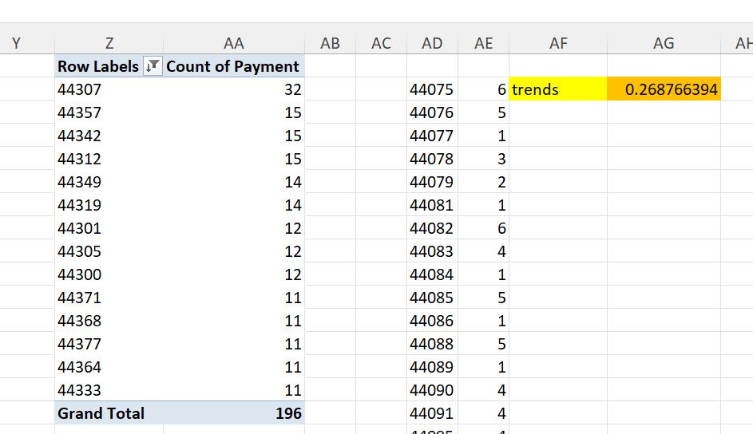
TASK 5

Slide 12
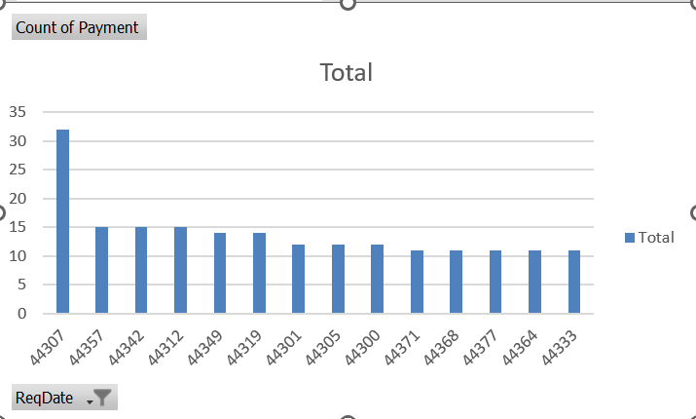
TASK 5

Slide 13
TASK 5 Inference
Yes, there is a trend between the distribution of payment type over time.
As the number of days moves on the distribution of payment time also increases.
It has a positive corelation of 0.268.

Slide 14
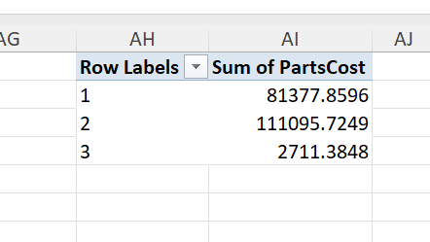
TASK 6

Slide 15
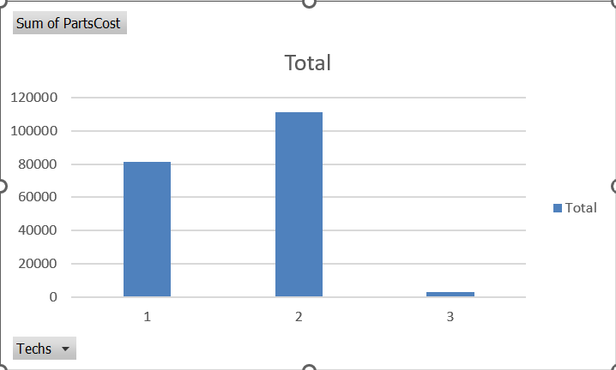
TASK 6

Slide 16
TASK 6 Inference
From the above images we can conclude that there is no relationship between the cost of parts and the number of technicians required to do the job.

Slide 17
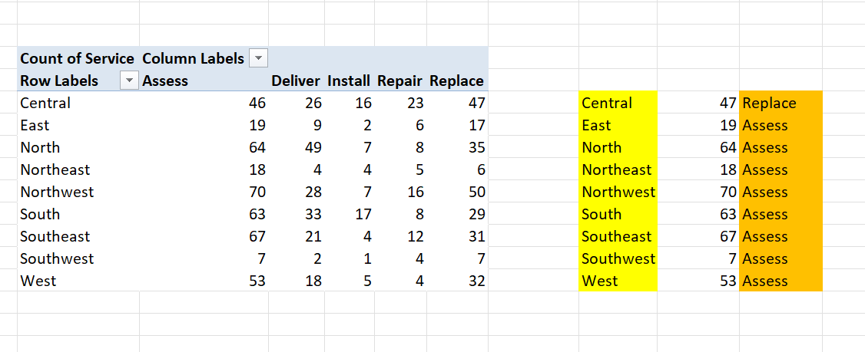
TASK 7

Slide 18
TASK 7 Inference
From the above image we can conclude that the most common type of service requested in each district is acces

Slide 19
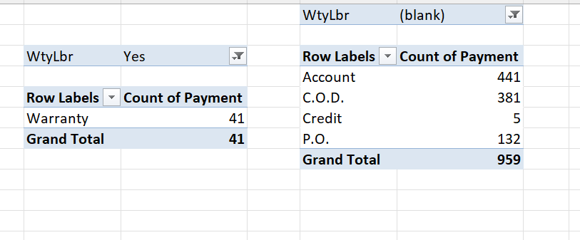
TASK 8

Slide 20
TASK 8 Inference
By looking at the pivot tables one with work orders with warranty labour and the other one without the warranty labour.
We can conclude that the people with the warranty pays the payment using the warranty.
Whereas the rest all without the warranty uses account,C.O.D ,credit and PO.

Slide 21
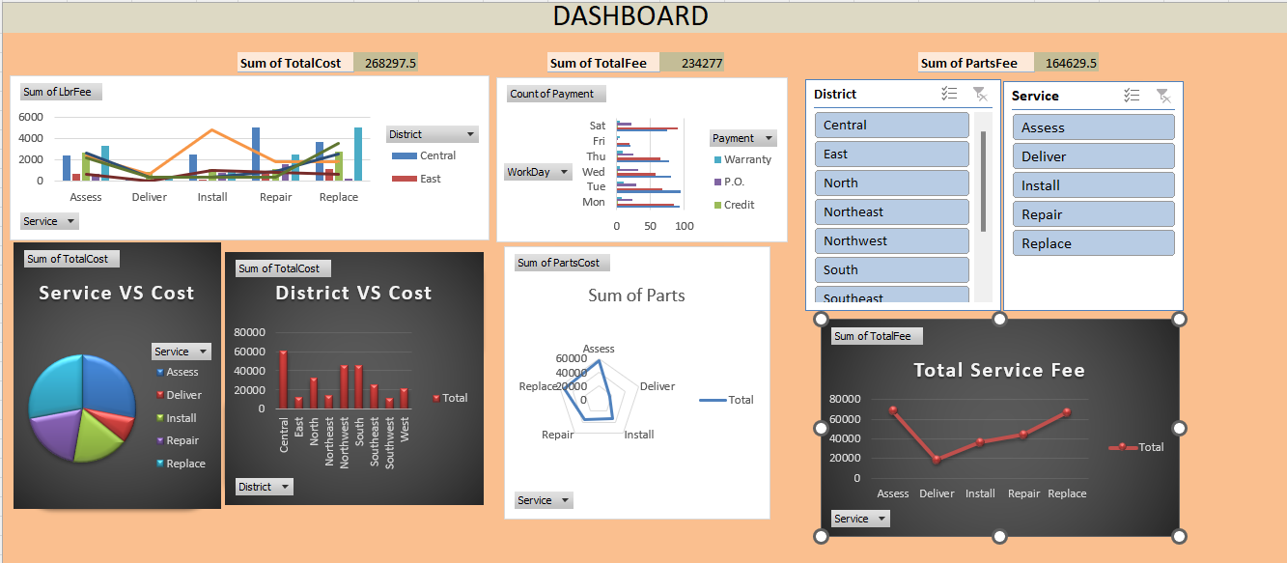
Dashboard

Slide 22
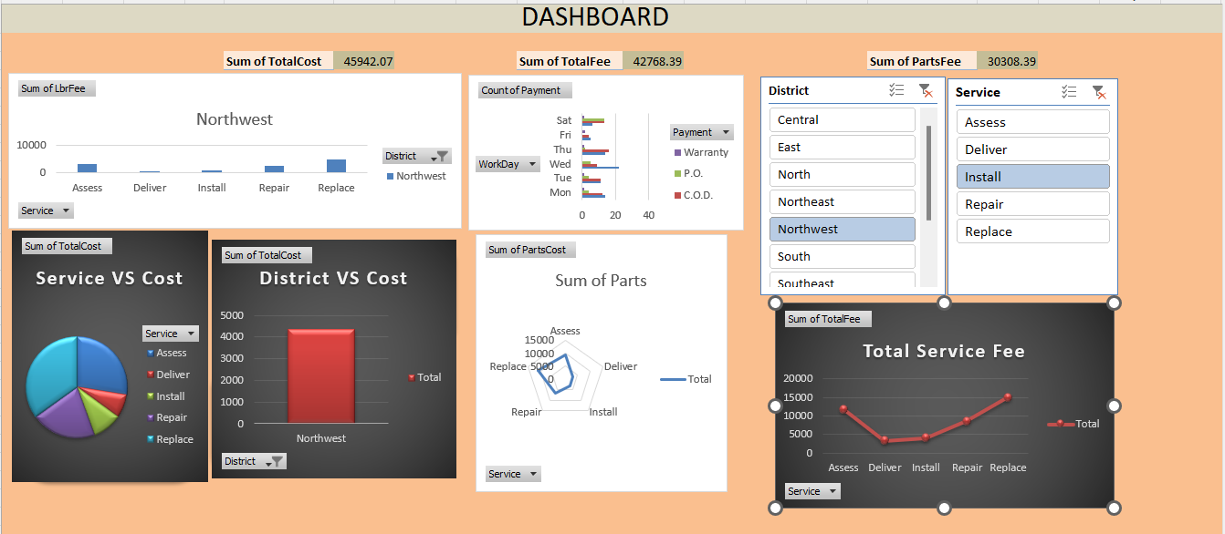
Dashboard

